Slide 1
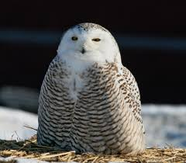
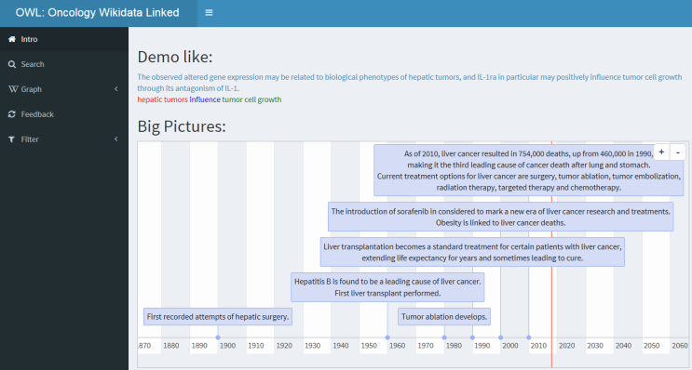
Demo for OWL
2017-11-9
Wangyq

Slide 2
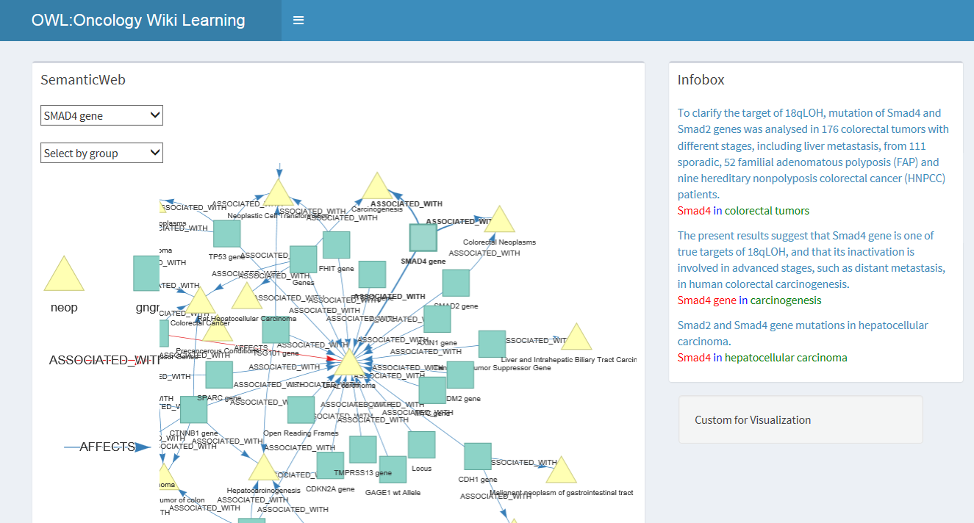
Landscape
Build on R 3.4.2
Fork me:
github.com/HustlerQian/LEARN_HCC

Slide 3
Outline
Goals
SemNet
Search

Slide 4
HCC—GENE—BIOMARKER Oncology Wikidata Literature
Tools
Make database link ,reading article and finding new research issue together

Slide 5
SemNet
Base
Filter
Cleaning & Unique >>>>> Search

Slide 6
Search Section
Undone
Datasource:
Wikidata infobox (NEED LABOUR!!!!)
How to display
Fuzzysearch in R (SelectInput)

Slide 7
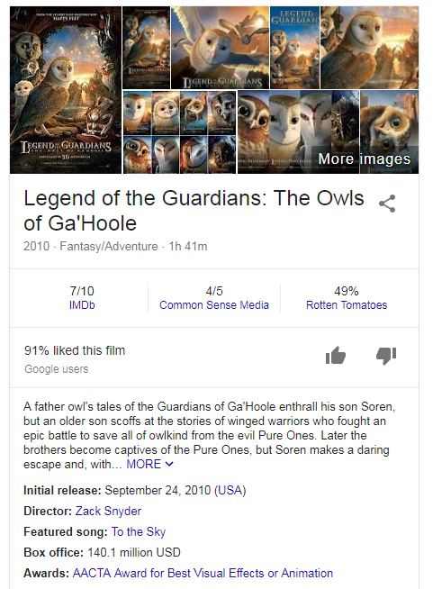
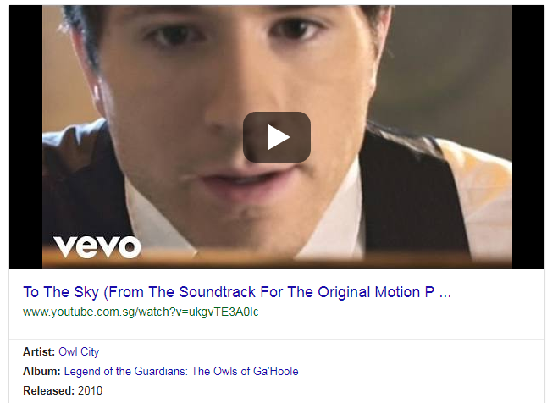
ADV

